Slide 1
Financial Institutions and Markets
Assignment - 2
ROLE OF AN UNDERWRITER IN IPO ISSUE
Group 3

Slide 2
IPO (Initial Public Offering)
What is an IPO?
It is a process by which a privately held company becomes a publicly-traded company by offering its shares to the public for the first time.
Why do companies go “Public”?
To Raise Capital
To Increase Liquidity
To improve Visibility and Credibility
To improve pecuniary situation

Slide 3
Underwriting
Underwriting is a process of transferring the risk to a person or institution by paying them charges in the form of premium.
The person or institutions to whom risk is transferred are known as Underwriters.
Underwriters agree to undertake the risk associated with an investment, venture or a loan in exchange for premium.

Slide 4
Role of an Underwriter
Assess the creditworthiness and risk of their potential customers before providing them financial services.
Setting optimum borrowing rate of loan or premium for issuing insurance policy.
Act as the intermediary between issuers of security and the investors.
Help the issuer with meeting Regulatory Requirements and setting up price of security.

Slide 5
In case of Stock Market
Underwriters guarantee the sale of a minimum amount of shares of companies in return for premium.
In case if these shares are not sold then underwriter will himself subscribe to such unsubscribed securities.
He cannot take any other benefit out of underwriting process except his commission.
Underwriter contacts prospective buyers of stock, such as mutual funds and insurance companies.
Underwriter takes the pulse of prospective buyers and then recommends an IPO price to the firm.

Slide 6
Types of Underwriting Agreements
Firm Commitment underwriting:
Underwriter guarantees to purchase all the securities offered for sale by the issuer regardless of whether they can sell them to investors.
2. Sub-Underwriting:
It is an underwriting agreement under which an underwriter appoints several other sub-underwriters to safeguard him.
3. Joint Underwriting:
More than one underwriter appointed by company for underwriting of its securities.

Slide 7
Types of Underwriting Agreements
4. Syndicate Underwriting:
Underwriting agreement in which several underwriters join together for underwriting securities. Such agreement takes place when issue is too big that a single underwriter cannot underwrite the whole amount.
5. Partial Underwriting:
Partial underwriting is one in which only a certain part of issue of securities of company is underwritten.

Slide 8
Discussing the role of an Underwriter -
3 Indian IPOS

Slide 9
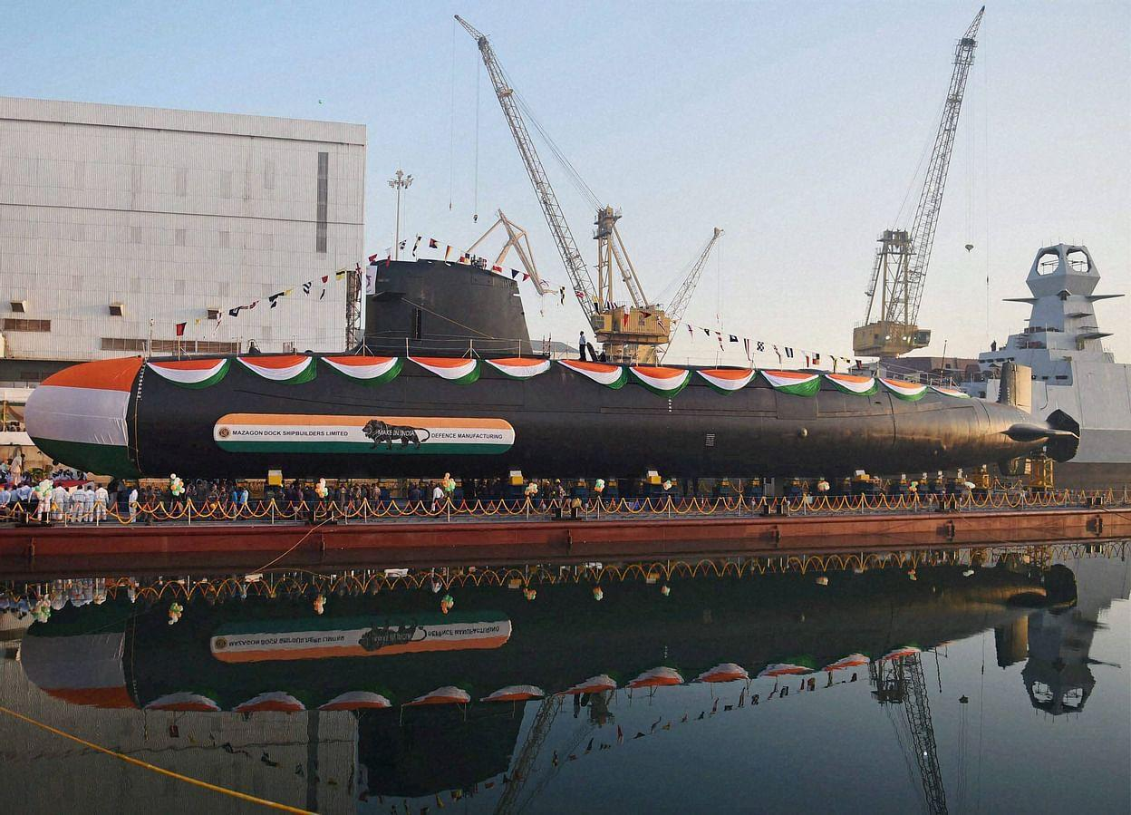

MAZAGON DOCK SHIPBUILDERS LTD
Big numbers catch the attention of your audience

Slide 10
ABOUT MAZAGON DOCK
India’s leading Mini-Ratna PSU shipyard under Ministry of Defence of
Only company with the ability to build 5 submarines at a time and the only shipyard to build destroyers and conventional submarines to be used by the Indian Navy.
Two key operating divisions - Shipbuilding division (70%) and Submarine and heavy engineering division (70%)
Till 2020, the company has built 795 vessels, including 25 warships, 4 missile boats, 3 submarines, 6 Leander class frigates, 3 Godavari class frigates, 3 Shivalik class frigates, 3 corvettes, and 6 destroyers.
Located on the west coast of India in Mazagon, Mumbai

Slide 11
DETAILS OF THE IPO
Price Band
₹135-₹145
Min. Lot Size
103 shares
Issue Size
38,987,081 equity shares OFS
Max. Lot Size
13
(103*13 = 1339 shares)
Issue Type
Book Built
Promoter Holding
Pre IPO - 100% Post IPO - 85.87%
IPO Quota
QIB = 50%
NII = 15%
Retail = 35%
IPO Registrar - Alankit Assignments Ltd.
IPO Lead Managers - YES Securities, Axis Capital, Edelweiss Financial, IDFC Securities and JM Financial
Promoter - Government of India

Slide 12
Financials of Mazagon Dock
(Figures in Rs crore)
 | FY 2016-17 | FY 2017-18 | FY 2018-19 | FY 2019-20
REVENUE | 3519 | 4470 | 4614 | 4978
EBITDA | 882 | 712 | 852 | 425
NET PROFIT | 598 | 496 | 532 | 477
MARGIN (%) | 25 | 16 | 19 | 9

Slide 13
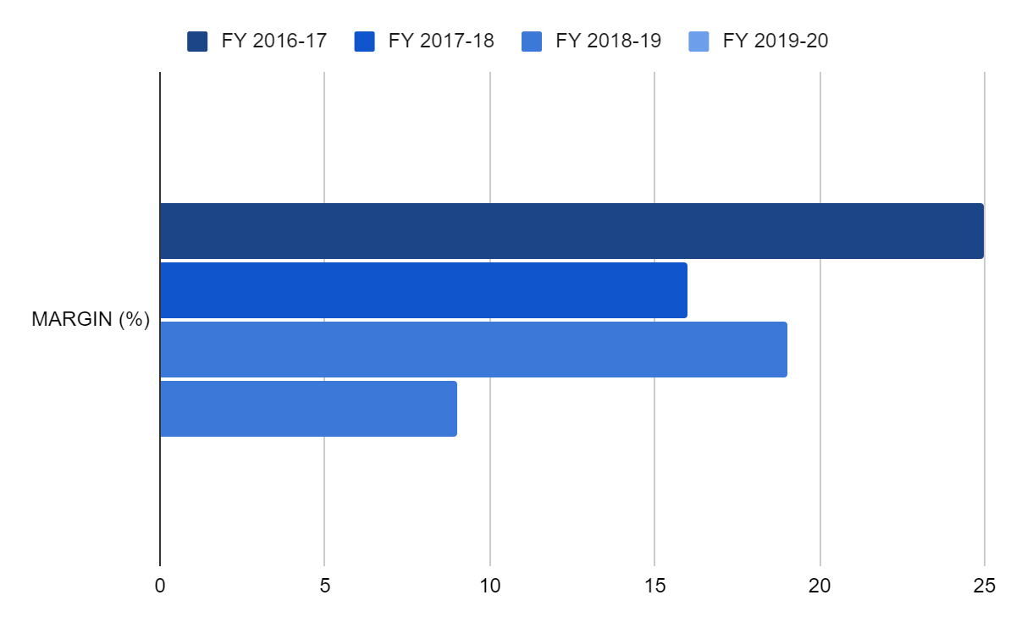
REASONS FOR GOING PUBLIC
GoI’s divestment drive in state-run entities
Atmanirbhar Bharat to have a positive impact
Declining Profit Margin

Slide 14
WHAT LIES AHEAD FOR MAZAGON
STRENGTHS
WEAKNESSES
OPPORTUNITIES
THREATS
Order book to grow 8-10% CAGR over the next 5 years
Experienced management team and skilful trained workforce
Largest shipbuilding company in terms of revenue in India
Only one client - MoD
Company
involved in tax proceedings which involves huge money
Fully regulated by GoI
Significant multiplier benefits
Additional investment in related sectors
Emerging into export orders
Unforeseen environmental costs
Delay of projects and costs/time overrun
Non-compliance in certain SEBI guidelines owing to the nature of the business

Slide 15


AVENUE SUPERMARTS LTD.

Slide 16
ABOUT AVENUE SUPERMARTS
An emerging national supermarket chain, with a focus on value-retailing
One of the largest and the most profitable F&G retailer in India with 196 stores located across 76 cities in India
Offers a wide range of products with a focus on the Foods, Non-Foods (FMCG) and General Merchandise & Apparel product categories
Predominantly an ownership model rather than on a rental model with focus on supply chain efficiencies
Operates distribution centres and packing centres to support its retail store network

Slide 17

DETAILS OF THE IPO
Price Band
₹295-₹299
Min. order quantity
50 shares
Issue Size
62,541,806 equity shares OFS
Face Value
₹10 per equity share
Issue Type
Book Built
Promoter Holding
Pre IPO - 100% Post IPO - 80.21%
IPO Quota
QIB = 50%
NII = 15%
Retail = 35%
IPO Registrar - Link Intime India Private Ltd.
IPO Lead Managers - ICICI Securities, Axis Capital, Edelweiss Financial, HDFC Bank, JM Financial, Kotak, SBI Capital, Motilal Oswal and Inga Capital
Promoter - Promoter and Promoter Groups (Damanis)

Slide 18
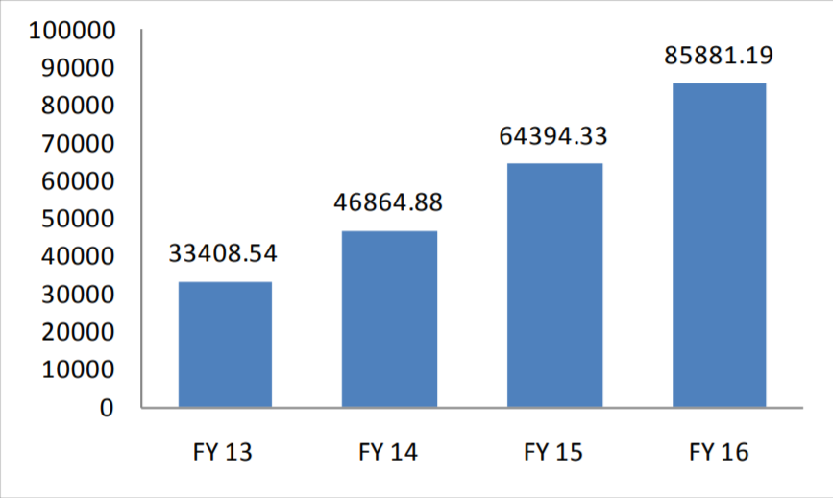
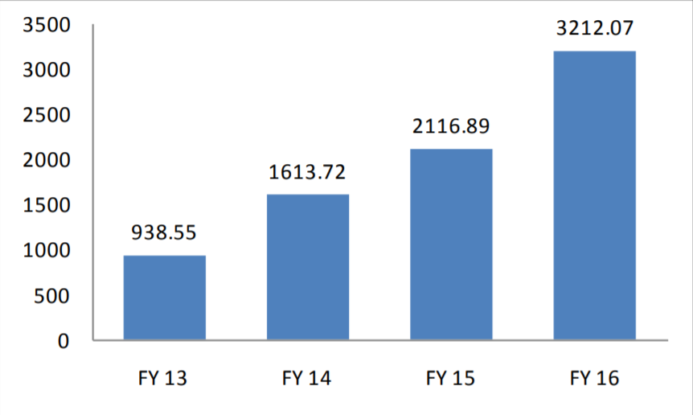
Financials of DMart
(Figures in Rs Millions)
Revenue from Operations
Net Profits

Slide 19
REASONS FOR GOING PUBLIC
Repayment or prepayment of a portion of loans and redemption
or earlier redemption of NCDs availed by the Company
Construction and purchase of fit outs for new stores
Deepen store network in southern and western India and gradually expand network in other parts of India pursuant to the cluster-focused expansion strategy
General Corporate Purposes

Slide 20

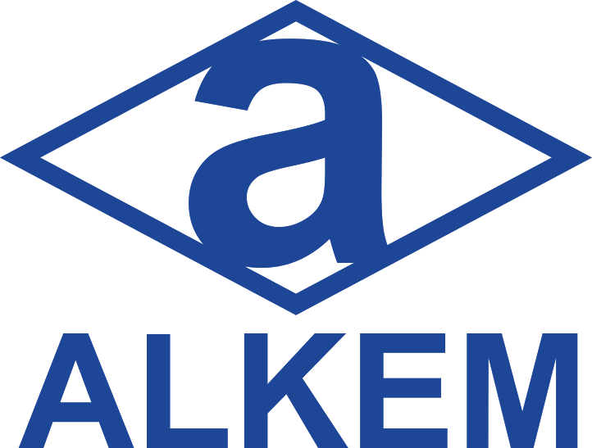
ALKEM LABORATORIES LIMITED

Slide 21
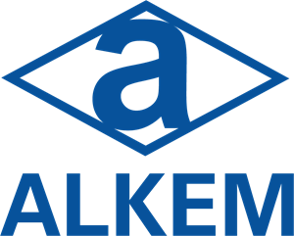
ABOUT ALKEM INDIA
Founded in 1973, Alkem is a leading Multinational pharmaceutical company with a strong domestic presence and global operations
Manufactures and Sells generic, formulations and nutraceuticals.
ALL is the seventh largest player in the domestic market with market share of 3.46% and it was the third-fastest growing company in terms of sales in FY13-15
Top player in the domestic market for anti-infectives, gastrointestinal, pain and analgesics
Has 21 Manufacturing units, over 800 brands, spread across 50 countries with a workforce of more than 14,000 and Consolidated Revenue at 73,572 Crores in FY 2018-19
Notes:
Alkem makes anti-diabetic, anti-malarial, cardiovascular, immunosuppressants, nutraceuticals and pain management products, among others.

Slide 22
DETAILS OF THE IPO
Price Band
₹1020-₹1050
Min. order quantity
14 shares
Issue Size
12,853,442 equity shares OFS
Face Value
₹2 per equity share
Issue Type
Book Built
Promoter Holding
Pre IPO - 100% Post IPO - 66.04%
IPO Quota
QIB = 19.5%
NII = 14.7%
Retail = 34.2%
IPO Registrar - Link Intime India Private Ltd.
IPO Lead Managers - Nomura Financial Advisory and Securities (India) Pvt Ltd., Axis Capital Ltd., J.P. Morgan India Pvt Ltd., Edelweiss Financial Services Ltd.
Promoter - Damanis, Promoter Groups and Private beneficiary Trusts

Slide 23
Financials of Alkem
(Figures in Rs crore)
 | FY 2016-17 | FY 2017-18 | FY 2018-19
EBITDA | 4992 | 5853 | 6431
NET PROFIT | 673.12 | 869.12 | 611.87
RESERVES | 3478.74 | 4443.74 | 4839.86

Slide 24
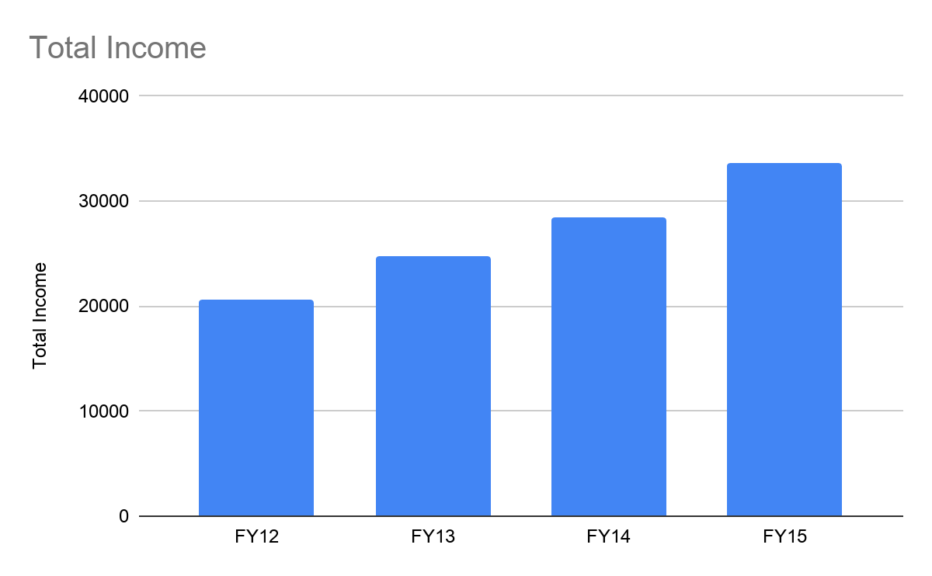
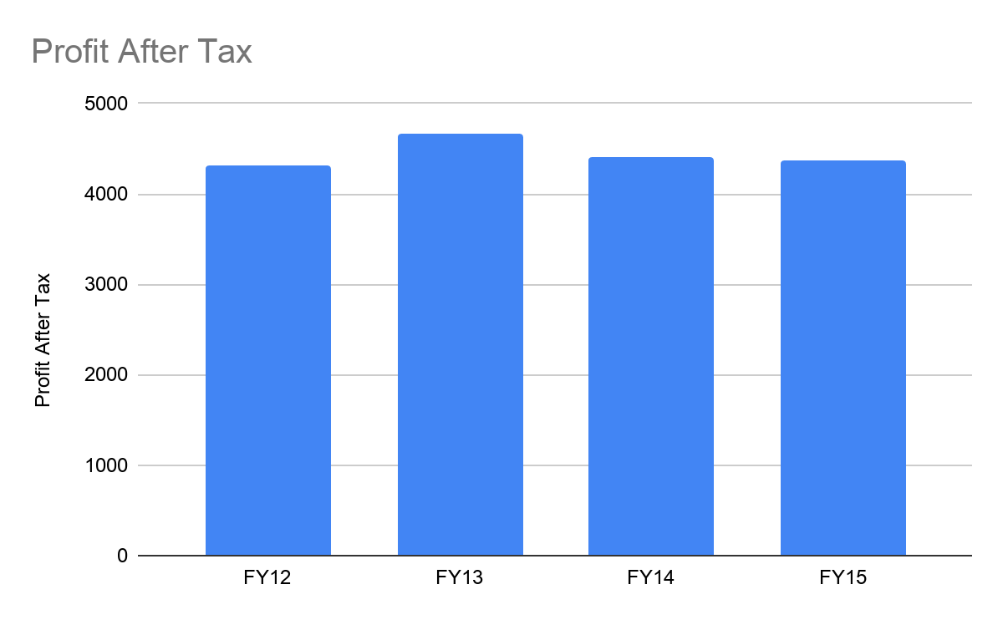
KEY FINANCIALS
(Figures in Rs crore)

Slide 25
WHAT LIES AHEAD FOR ALKEM
STRENGTHS
WEAKNESSES
OPPORTUNITIES
THREATS
Established player in domestic market
Manufacturing Capabilities
achieved EoS
Ample R&D capabilities
Competition and pricing issues in domestic markets
Litigation/compliance issues in international markets
US Franchisee looks promising
Vertical Integration for added benefits like insurance, clinical tests , medical tourism
Lack of Strong IPR Protection in India
Counterfeit drugs widespread

Slide 26
REASONS FOR GOING PUBLIC
Alkem Laboratories planned to expand its footprint globally
Livemint reported that the firm is looking at acquisition opportunities in India and US
Acquire a pharma company in the chronic diseases space

Slide 27
THANK YOU !
Group 3
Kunal Singh - 17EX20015
Shreyash Panat - 17IM3FP12
Suresh Pathlavath - 16BT30028
Tejaswi Pagadala - 19MT10027

